Slide 1

Predictive Analytics Tool for Early Diabetes Risk Detection.
(Final Project Presentation)
MSBD-532-01
Team 2 - Naija Thomas, Olayinka Ajao, Pamela Djan
April 25, 2024

Slide 2
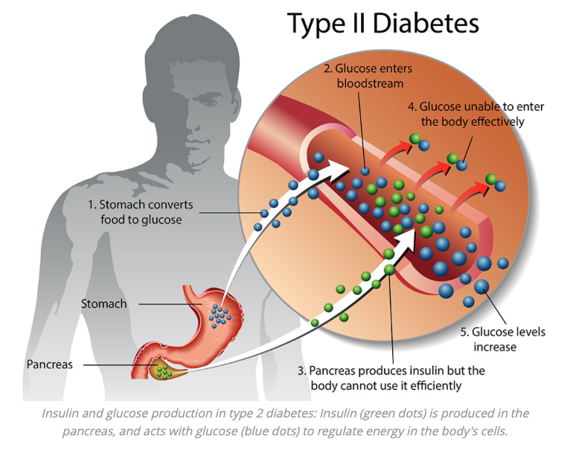

GOAL
Develop a predictive analytics software tool that uses machine learning to analyze healthcare data, identifying individuals at high risk of developing diabetes, particularly Type 2 diabetes, at an early stage.

Slide 3
Project Milestone
Week 1 – 6: Data Collection and Analysis
Identified and gathered relevant datasets.
Planned the data analysis approach, including the selection of machine learning algorithms.
Output:
A list of data sources and datasets.
Data analysis strategy document.
Notes:
Resources document in Google Drive is our list of sources/ datasets we can show.
We can go through our Data Analysis Strategy document during the presentation.

Slide 4
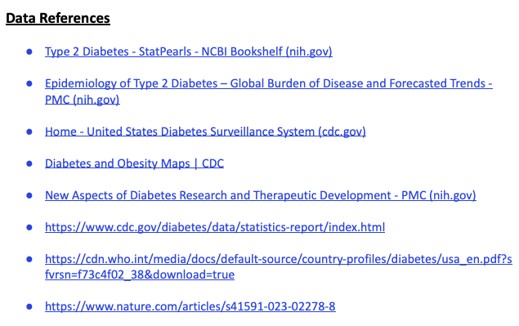
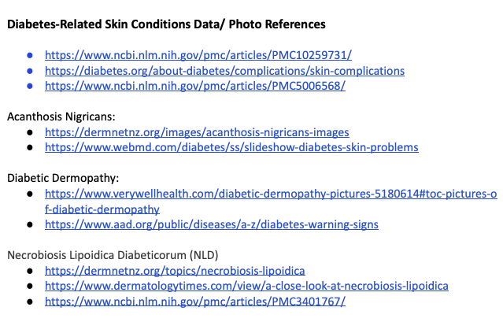
List of Data Sources and Datasets
Notes:
List of sources/ datasets we can show.

Slide 5
Data Analysis Strategy Document
Our Data Analysis Strategy document is included in our final project report.
Notes:
List of sources/ datasets we can show.

Slide 6
Project Milestone
Week 4 - 6: Prototype Design
Design the basic architecture of the predictive analytics tool.
Develop mock-ups of the user interface.
Output:
Basic model flow diagram.
UI mockup.
Notes:
We can show the basic flow diagram.
Include screenshot of UI Mockup.

Slide 7
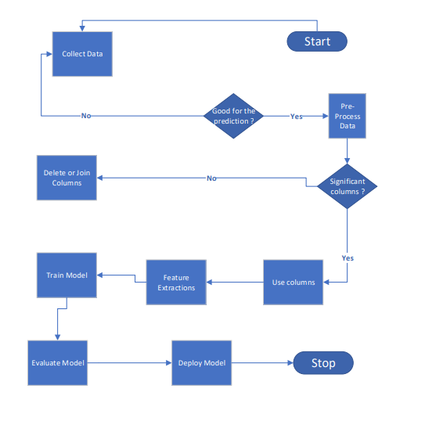
Basic Model Flow Diagram
Notes:
Explain basic flow diagram.

Slide 8
Project Milestone
Week 7 - 8: Prototype Refinement
Refine machine learning models based on initial testing.
Improve the user interface based on feedback .
Output:
Updated prototype with enhanced functionality.
Notes:
We can show the basic flow diagram.
Include screenshot of UI Mockup.

Slide 9
Project Milestone
Week 9 - 10: Testing and Iteration
Conduct thorough testing of the prototype, including algorithm accuracy and user interface usability.
Test with historical data.
Evaluate the tool’s impact on patient outcomes and decision-making.
Gather feedback and make necessary adjustments.
Output:
Test results report.
Revised prototype.
Notes:
We can show the basic flow diagram.
Include screenshot of UI Mockup.

Slide 10
Project Milestone
Week 11 - 12: Finalization and Presentation Preparation
Finalize the prototype based on feedback and test result.
Prepare a presentation to showcase the project, including demonstrations of the tool.
Output:
Final project report.
Presentation slides and materials.
Notes:
We can show the basic flow diagram.
Include screenshot of UI Mockup.

Slide 11
Project Milestone
Week 13 - 14: Presentation and Submission
Present the completed project to the class.
Submit all project outputs.
Output:
Final presentation.
Complete project documentation and code.
Notes:
We can show the basic flow diagram.
Include screenshot of UI Mockup.

Slide 12
Analysis Methodology
To create a robust data analysis strategy for diabetes risk prediction using machine learning, we follow a structured approach involving several phases, each with specific tasks and objectives.
Phase 1: Data Collection
The objective here was to acquire and prepare a dataset for analysis.
Phase 2: Model Development
The objective here was to build initial predictive models using the cleaned dataset.
Phase 3: Model Refinement
The objective here was to optimize the performance of the models.
Phase 4: Analysis and Reporting
The objective here was to evaluate the models’ performance on the test set and report findings.

Slide 13
Key Findings
From our feature selection graph, the most predictive features in the diabetes prediction model are:
Glucose
BMI
Age
Diabetes Pedigree Function
From our results and performance of the model, some potential model insights are:
Random Forest Classifier Performance.
Model Precision of 0.86.
Imbalance in Feature Impact.
Notes:
From the results performance of the model, potential insights:
Random Forest Classifier Performance: The Random Forest model had a higher F1 score compared to other models, suggesting that it managed to find a better balance between precision and recall, making it suitable for this dataset.
Precision of 0.86: Indicates that when the model predicts a patient has diabetes, it is correct approximately 86% of the time.
Imbalance in Feature Impact: Some features have a substantially larger impact on the model's predictions than others, which can be typical in medical datasets where certain measurements are more diagnostic of the condition in question.

Slide 14
Ethical Considerations
Ensure data privacy and security, especially since this is sensitive health information.
Ensure all patient data is anonymized and securely stored.
Comply with all relevant data protection regulations (e.g., HIPAA, GDPR).
Assess and mitigate potential biases in the data collection and model training processes.
Ensure the tool is fair and equitable across different patient demographics.

Slide 15
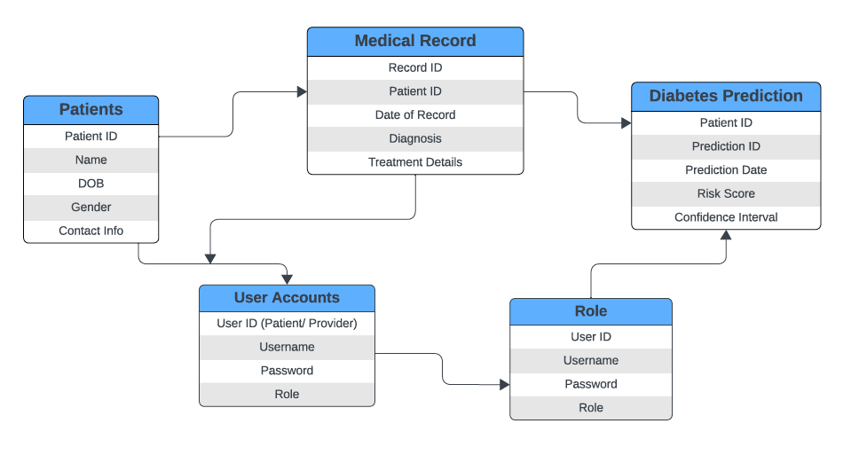
Database Design Diagram
Notes:
Database schema diagram to outline the structure of a health information system incorporating diabetes prediction. The diagram includes several related entities: Patients, Medical Record, Diabetes Prediction, User Accounts, and Role.
Patients: This table holds personal information about the patient, such as ID, name, date of birth, gender, and contact information.
Medical Record: This is linked to Patients by Patient ID and contains records of patient visits, including diagnosis and treatment details.
Diabetes Prediction: This is related to the output of the predictive model, storing the prediction results, associated risk scores, and the confidence intervals of the predictions. It is linked to the patient data.
User Accounts: This controls access to the system and could include both patients and providers. It is linked to the patient's data and includes information on user roles.
Role: This specifies the role of a user in the system, which could define permissions for access to various parts of the data.
Based on this schema, the system is designed to support not just the storage of medical and patient data, but also the integration of a machine learning model for diabetes risk prediction.

Slide 16

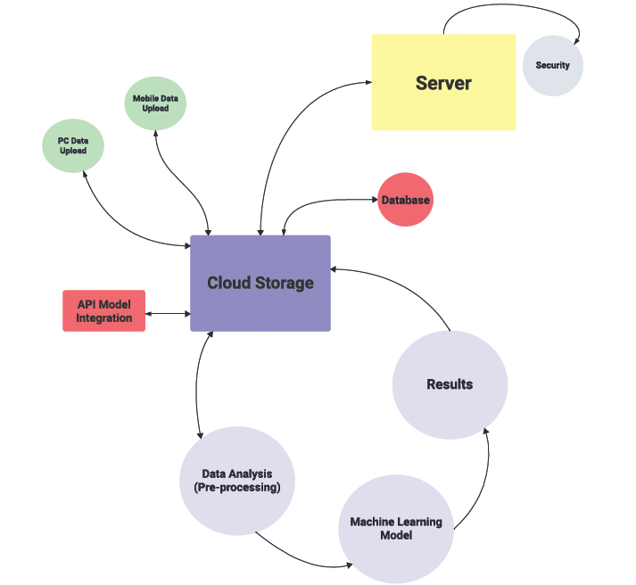




System Architecture Diagram
Notes:
A system architecture diagram that describes a cloud-based solution involving various components for data handling and machine learning model integration.
The system includes the following components:
Cloud Storage: Acts as a central repository for data collected from different sources.
Server: Manages interactions between the cloud storage and the database and handles security to protect the data and system integrity.
Database: Stores and organizes data, including both raw data and processed results.
Data Analysis (Pre-processing): A component where data is cleaned, transformed, and prepared for analysis.
Machine Learning Model: The part of the system where predictive modeling takes place. It consumes pre-processed data to train models and generate predictions.
Results: A module that presents the outcome of the machine learning analysis, possibly including predictions, risk scores, or other actionable insights.
API Model Integration: A way to connect the machine learning model to other applications or services via an API, allowing for integration with external systems.
Mobile Data Upload and PC Data Upload: Different data ingestion pathways indicating that the system can receive data from various device types, ensuring flexibility in how data is collected.
The flow between these components suggests a comprehensive system designed for scalability and flexibility, capable of supporting a wide range of data sources and consumer applications.
This type of architecture is typical for modern, cloud-based applications that require real-time data processing and integration of advanced analytics like machine learning models.

Slide 17
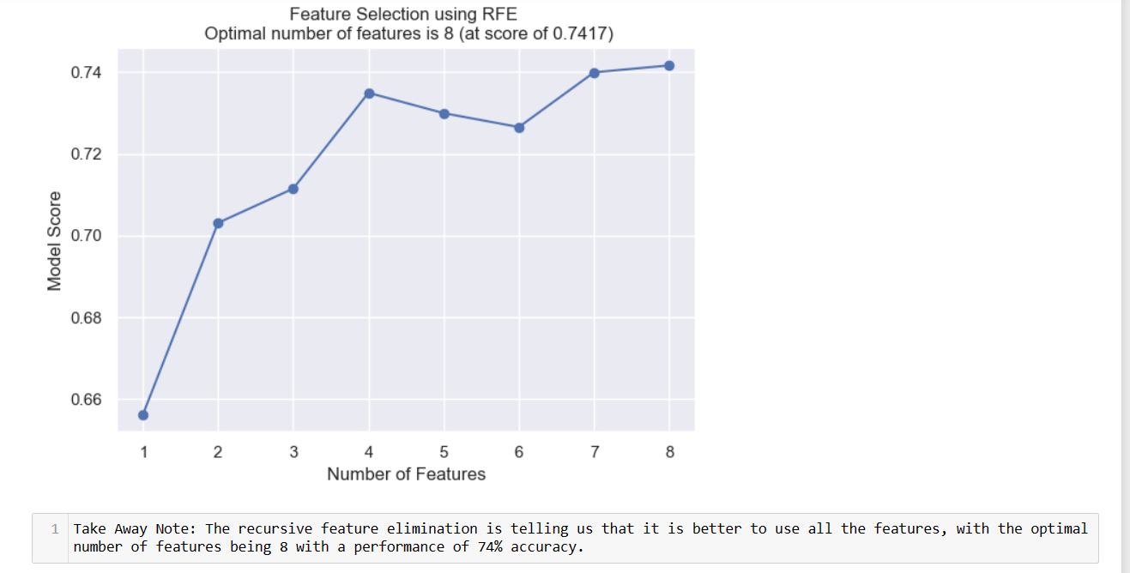
Feature Selection
Notes:
Screenshot of UI Mockup

Slide 18
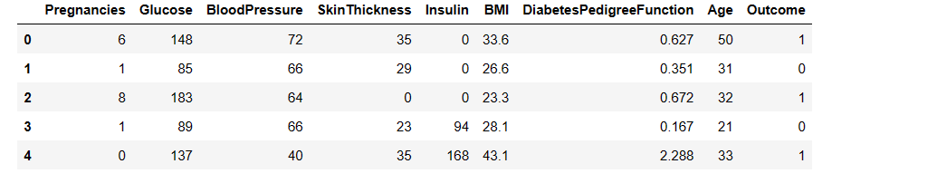
Data Columns
Notes:
Screenshot of UI Mockup

Slide 19
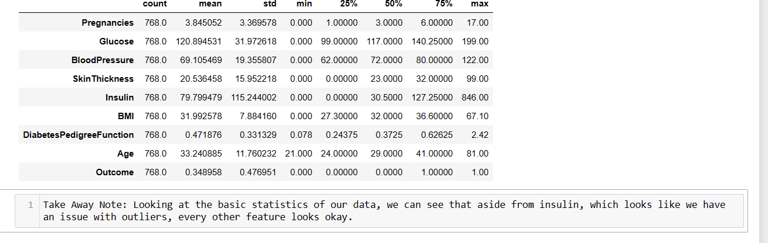
Data Basic Descriptive Statistics
Notes:
Screenshot of UI Mockup

Slide 20
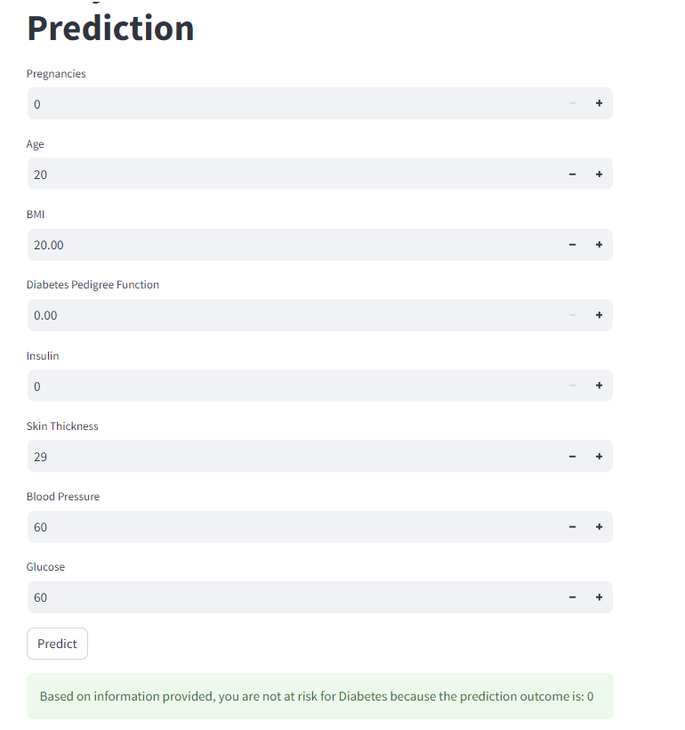
Prediction Output
Notes:
Screenshot of UI Mockup

Slide 21
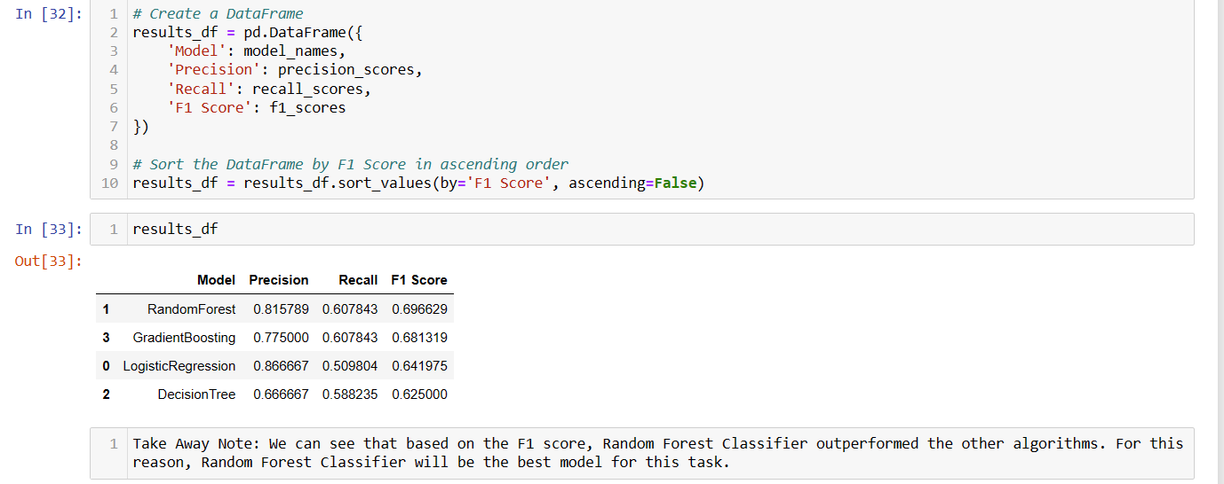
Model F1 Scores
Notes:
Screenshot of UI Mockup

Slide 22
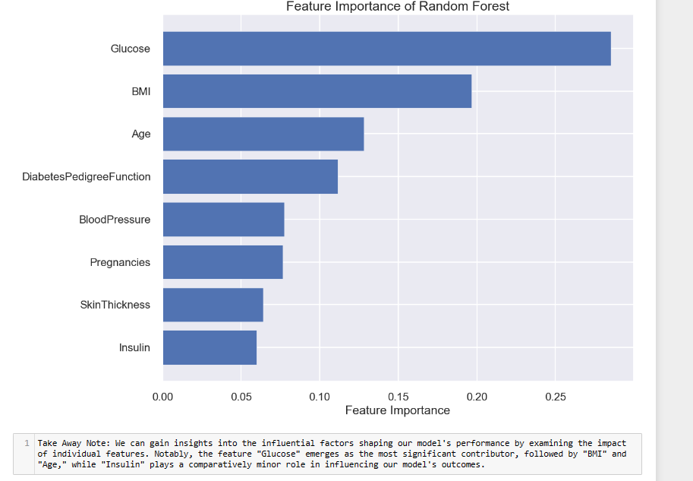
Feature Importance
Notes:
Screenshot of UI Mockup

Slide 23
Discussion
Diabetes is a global health concern, affecting 537 million people worldwide, making it one of the deadliest and most common non-communicable diseases.
Key factors observed in the data for diabetes risk include BMI, glucose, age, diabetes pedigree function, insulin, blood pressure, skin thickness, and pregnancies.
Early prediction of diabetes is essential to reduce the risk and complications associated with the disease.
The developed predictive analytics tool utilized machine learning approaches and the open-source Pima Indian dataset.
Preprocessing techniques were employed such as feature selection.
Performance metrics such as precision, recall, and F1 score were used to evaluate the effectiveness of the tool.
The tool achieved a precision of 0.86 for the logistic regression classifier, but it was determined that the random forest model would be better suited for this dataset in terms of overall performance and accuracy.
The tool has been deployed as a user-friendly application accessible through various devices.
Further improvements include expanding the dataset with a larger patient cohort and applying advanced machine learning, logical techniques, and optimization approaches.
Ongoing efforts aim to provide best practices for diabetes risk factors and enhance the overall effectiveness of the tool.
Notes:
We can show the basic flow diagram.
Include screenshot of UI Mockup.

Slide 24
Conclusion
Timely identification of diabetes can significantly mitigate the risks and mitigate the potential complications associated with the disease.
The developed predictive analytics tool enables early diabetes risk detection using machine learning approaches.
Key factors such as BMI, glucose, age, and diabetes pedigree function are identified as important indicators of diabetes risk.
The tool achieved promising results, with a precision of 0.86, indicating a relatively low rate of false positives (86% accuracy in positive predictions).
The recall and F1 scores suggest that there is room for improvement in the model's performance, particularly in reducing the rate of false negatives.
The project aims to contribute to reducing the impact of diabetes on individuals' health and improving their overall well-being.
Further attention should be given to addressing the moderate rate of false negatives and enhancing the model's performance through thorough analysis and refinement.
Notes:
We can show the basic flow diagram.
Include screenshot of UI Mockup.

Slide 25
Future Research Directions
Investigate more sophisticated algorithms that could improve the model's performance.
Explore additional features that may increase predictive power, including socio-economic data, environmental factors, and more granular patient history.
Conduct randomized controlled trials to validate the tool’s predictive accuracy and its ability to improve clinical outcomes
Test the model across diverse populations to ensure its accuracy across different ethnicities, age groups, and geographies.
Incorporate the tool into Clinical Decision Support Systems (CDSS) to provide real-time guidance during patient consultations.
Collaborative efforts with healthcare professionals and stakeholders in the field will ensure the tool aligns with clinical best practices and guidelines.
Notes:
We can show the basic flow diagram.
Include screenshot of UI Mockup.

Slide 26
References
Data References
Type 2 Diabetes - StatPearls - NCBI Bookshelf (nih.gov)
Epidemiology of Type 2 Diabetes – Global Burden of Disease and Forecasted Trends - PMC (nih.gov)
Home - United States Diabetes Surveillance System (cdc.gov)
Diabetes and Obesity Maps | CDC
New Aspects of Diabetes Research and Therapeutic Development - PMC (nih.gov)
https://www.cdc.gov/diabetes/data/statistics-report/index.html https://cdn.who.int/media/docs/default-source/country-profiles/diabetes/usa_en.pdf?sfvrsn=f73c4f02_38&download=true https://www.nature.com/articles/s41591-023-02278-8
Model References
Artificial Intelligence in Current Diabetes Management and Prediction - PMC (nih.gov)
Overview of clinical prediction models - PMC (nih.gov)
Diabetes Prediction using Machine Learning Techniques – IJERT
Predicting Diabetes in Medical Datasets Using Machine Learning Techniques (ijser.org)
Use and performance of machine learning models for type 2 diabetes prediction in clinical and community care settings: Protocol for a systematic review and meta-analysis of predictive modeling studies - PMC (nih.gov)
Machine learning and deep learning predictive models for type 2 diabetes: a systematic review | Diabetology & Metabolic Syndrome | Full Text (biomedcentral.com)

Slide 27
Thank You for Your Attention!
Any Questions?

